Slide 1
GE8151 Problem Solving and Python Programming
Rajasekaran S
Assistant Professor,
Department of Information Technology,
KGiSL Institute of Technology,
email: proffraja@gmail.com
Github:www.github.com/rajasekaranap

Slide 2
Modules
The file in which the python code and function definitions are saved is referred to as modules. Files are saved with extension (.py). Modules can be imported in scripts.

Slide 3
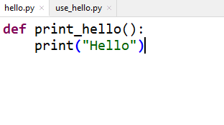
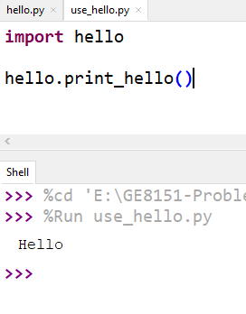
Example
Importing
Module
Module

Slide 4
Types of Importing Modules
Simple Import
Import single attribute from module
Import all attributes from module

Slide 5
Simple Import
It helps to import entire module.
Syntax:
import math
It imports math module only.

Slide 6
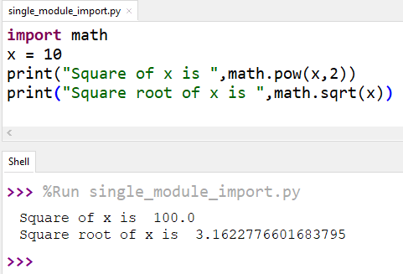
Example

Slide 7
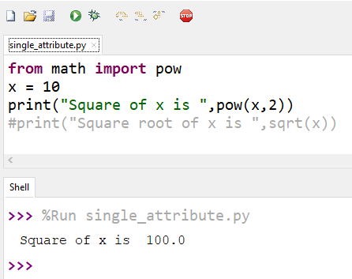
Importing Single Attribute
from module_name import attribute_name
Only pow is imported from math sqrt not imported

Slide 8
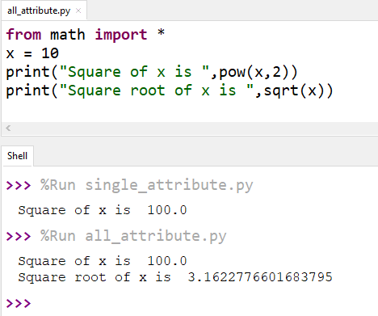
Importing All Attributes
from module_name import *
Only pow is imported from math sqrt not imported

Slide 9
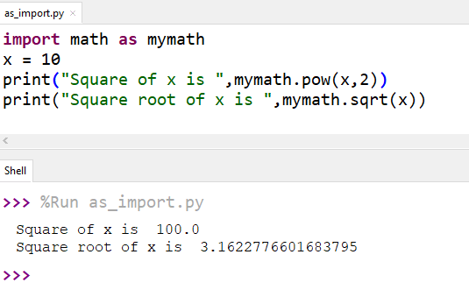
Import as
import module_name as custom_name
It helps to access the module with custom names.
It helps to overcome the naming confusions.

Slide 10
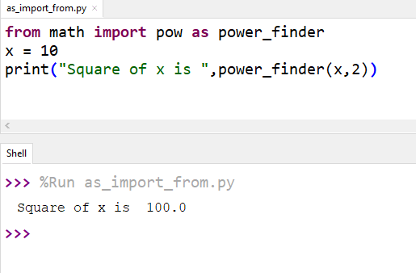
Single Attribute Import with Custom name

Slide 11
Thank You
Rajasekaran S
Assistant Professor,
Department of Information Technology,
KGiSL Institute of Technology,
email: proffraja@gmail.com
Github:www.github.com/rajasekaranap

